Slide 2
Aim
To understand and use comparative adjectives.
To understand and use superlative adjectives.

Slide 3
What Is a Comparative Adjective?
A comparative adjective is used to compare one person, action, thing or state to another. It adds the suffix -er to the original adjective.
e.g. brighter
‘bright’ is the original adjective.
‘-er’ is the suffix.
It is comparing two things only.
E.g. Sam’s torch is brighter than John’s torch.

Slide 4

What Is a Comparative Adjective?
The suffix -er is added to the end of the original adjective to show that it is being compared to one other person, action, thing or state.
Sometimes, the root adjective spelling does not change.
e.g. warm
The weather is warmer today than yesterday.
Other times, the root adjective spelling changes, as in these examples:
e.g. happy
The boy is happier than the girl.
e.g. big
My car is bigger than yours.

Slide 5
What Is a Comparative Adjective?
Can you add the suffix ‘-er’ to these adjectives, to turn them into comparative adjectives and then put them in a sentence?
Can you write your sentences down? Take care with your spellings.
e.g. small
The mouse was smaller than the elephant.
wet
hot
wetter
hotter
long
longer
shiny
light
shinier
lighter
bright
brighter
(Click to reveal the answer.)

Slide 6
What Is a Superlative Adjective?
A superlative adjective is used to compare one person, action, thing or state to all others in the same group. It adds the suffix - est to the original adjective.
e.g. quietest
‘quiet’ is the original adjective.
‘-est’ is the suffix.
It is comparing more than two things only.
E.g. Aisha is the quietest in the class.

Slide 7
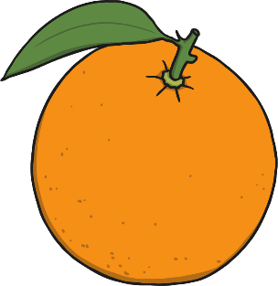
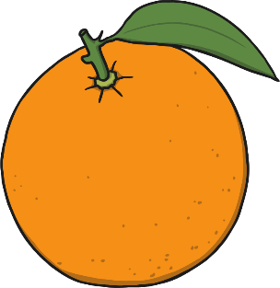
What Is a Superlative Adjective?
The suffix -est is added to the end of the original adjective to show that it is being compared to two or more people, actions, things or states.
Sometimes, the root adjective spelling does not change.
e.g. quick
The girl is the quickest of them all.
Other times, the root adjective spelling changes, as in these examples:
e.g. juicy
The orange is the juiciest of the fruits.
e.g. hot
Leeds was the hottest city on Wednesday.

Slide 8
What Is a Superlative Adjective?
Can you add ‘-est’ to these adjectives, to turn them into superlative adjectives and then put them in a sentence?
Can you write your sentences down? Take care with your spellings.
e.g. cold
It was the coldest day in January so far.
dry
thin
driest
thinnest
short
shortest
funny
dark
funniest
darkest
dull
dullest
(Click to reveal the answer.)

Slide 9
Spelling Rules
Most words can simply have the suffix –er and –est added to the end of them without having to make any changes to the root adjective.
However, there are some words that you need to watch out for!
Words that end in a ‘y’
These words need to have the ‘y’ changed into an ‘i’ before adding the suffix.
e.g.
heavy → heavier
tiny → tiniest
Double consonants
Words that end in one vowel and then one consonant need to have the last consonant doubled.
e.g.
flat → flatter
slim → slimmest
Words that end in an ‘e’
Words that end in an ‘e’ need to have the ‘e’ removed before the suffix is ended.
e.g.
large → larger
fine → finest

